Slide 1
Day 3

Slide 2
Agenda
Action Bar Button
RatingBar
CardView
RecyclerView
List Item Layout
Model
ViewHolder
Adapter
24/05/2021
Basic Java
2

Slide 3
Action Bar Button

Slide 4

Action Bar Button
Action Bar Button is a button that exist right side of the Action Bar.
Space in the app bar is limited. So make sure action bar must be less than 3.

Slide 5
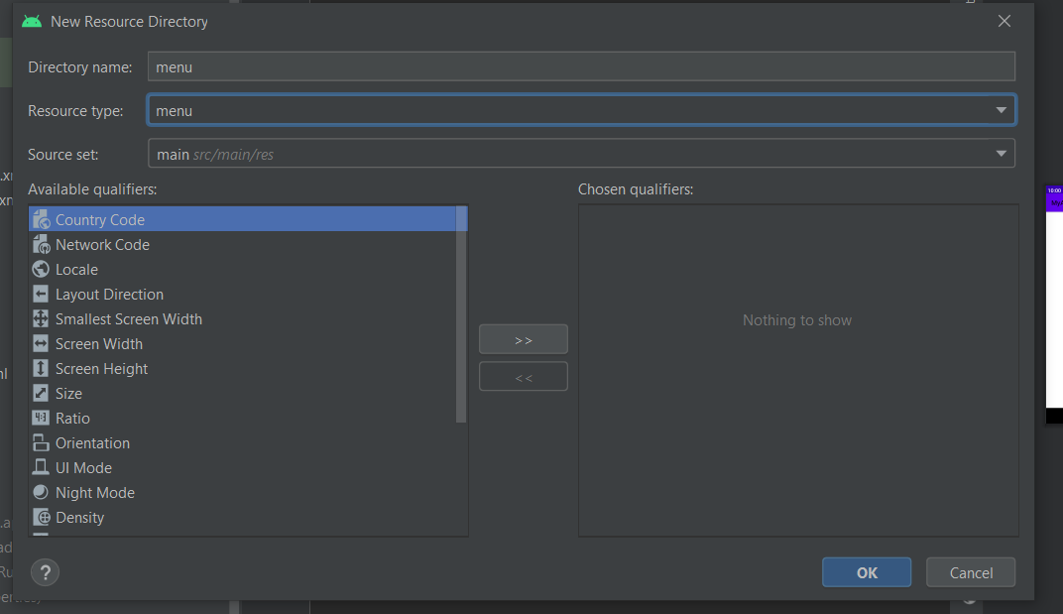
Action Bar Button
First we need layout for the action bar button.
Right click on app folder -> New -> Android Resource Directory
Select Resource type as “menu” and click “OK”.

Slide 6

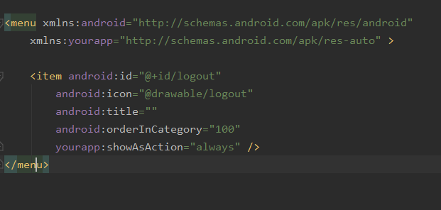
Action Bar Button
Create a new layout in menu as “main_activity_actions” (You can name anything doesn’t matter).
Now we have two tag:
Menu: It is the main parent tag.
Item: It is used as action bar button. It can be shown either with icon or text.
For action bar button, write the attribute inside the item tag.

Slide 7
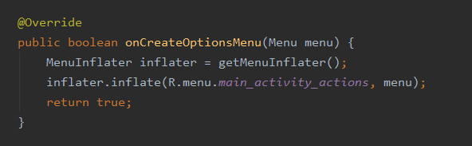
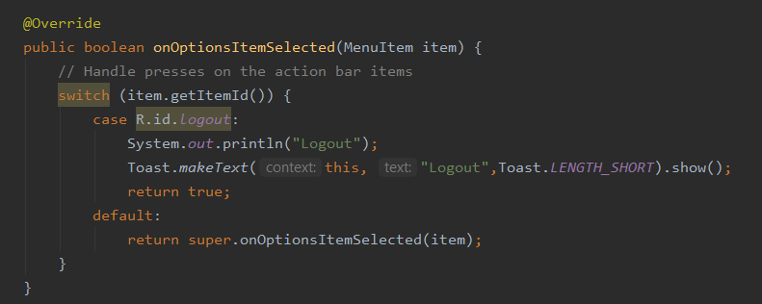
Action Bar Button
We need two function for this to work.
onCreateOptionMenu function is used to initialize and assign menu layout.
onOptionsItemSelected is used as a listener for the action bar button which gives clicked Menu Item from which you can extract ID using item.getItemId().

Slide 8
RatingBar

Slide 9
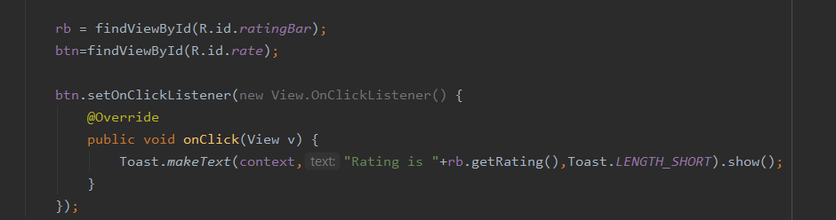
RatingBar
Android RatingBar can be used to get the rating from the user.
The Rating returns a floating-point number. It may be 2.0, 3.5, 4.0 etc.
The getRating() method of android RatingBar class returns the rating number.

Slide 10
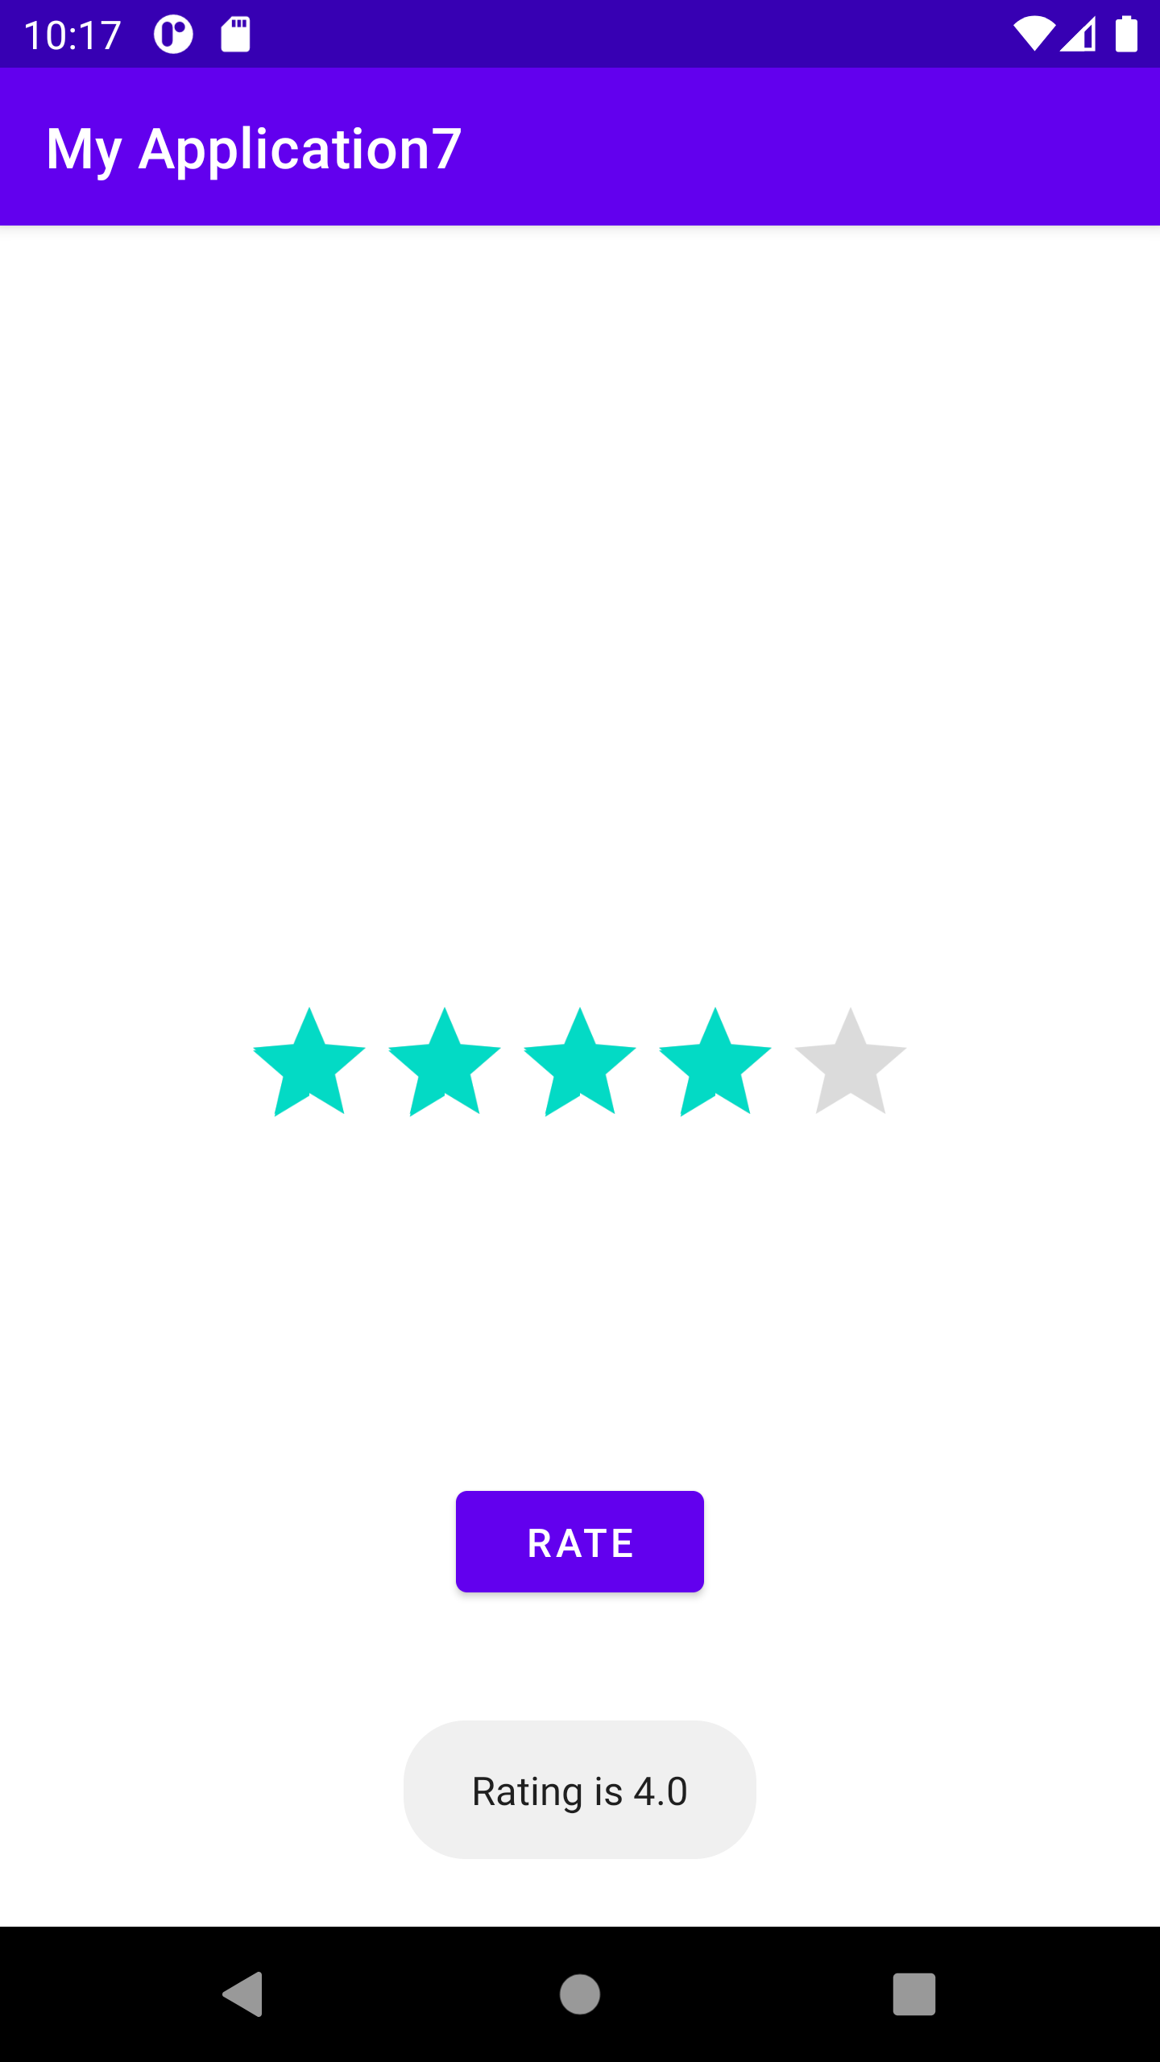
RatingBar

Slide 11
CardView

Slide 12
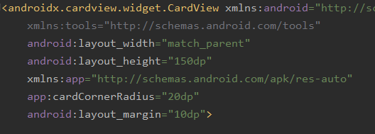
CardView
CardView is a new widget in Android that can be used to display any sort of data by providing a rounded corner layout along with a specific elevation.

Slide 13
RecyclerView

Slide 14
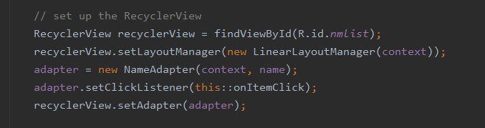
RecyclerView
RecyclerView makes it easy to efficiently display large sets of data.
It requires four main component:
Adapter
ViewHolder
Model (Class)
List Item Layout
To set the adapter ,write recycler.setAdapter(adapter).

Slide 15
List Item Layout

Slide 16
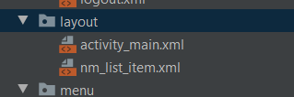
List Item Layout
This layout is used to design the view and widgets for List item.
The layout must be assigned in onCreateViewHolder function.
Layout can be created by: Right Click on Layout -> New -> Layout Resource File
Here nm_list_item is the xml layout file created for the list item.

Slide 17
Model

Slide 18
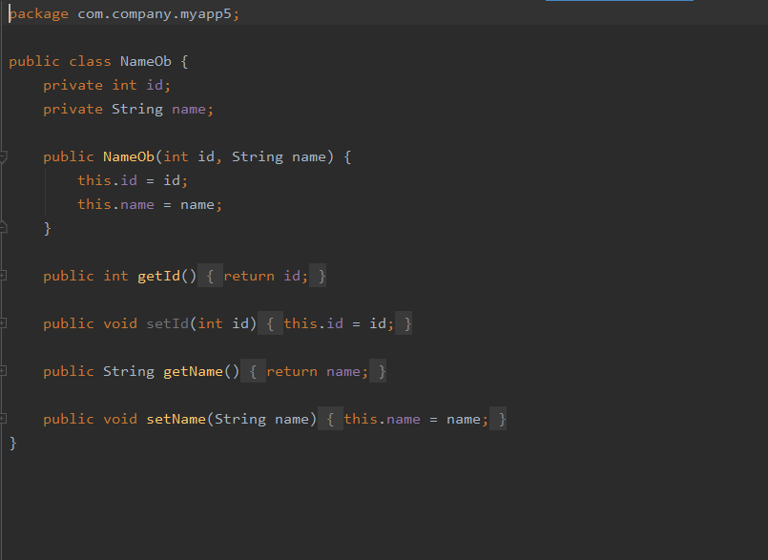
Model
Model is a class used to store a bunch of variables and methods(mostly getters and setters).
Model helps to separate and group data into systematic manner

Slide 19
ViewHolder

Slide 20
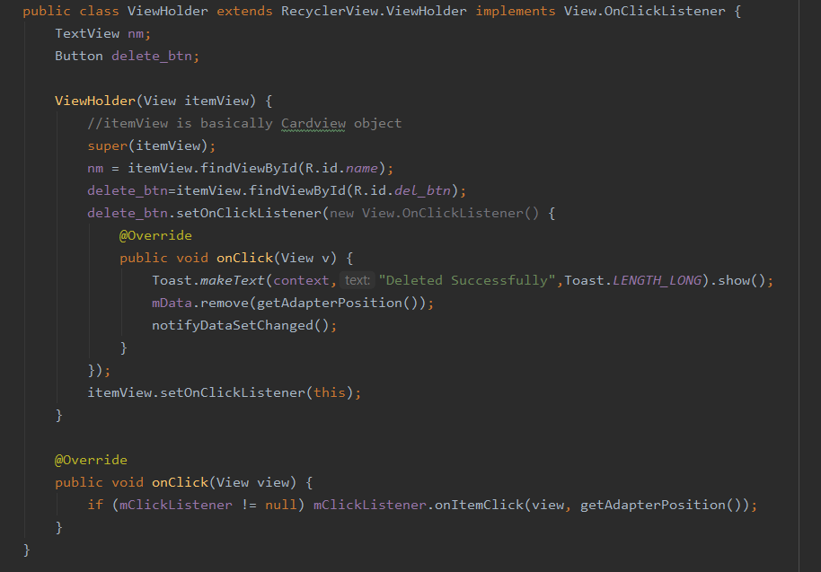
ViewHolder
The ViewHolder is a wrapper around a View that contains the layout for an individual item in the list.
The Adapter creates ViewHolder objects as needed, and also sets the data for those views. The process of associating views to their data is called binding.

Slide 21
Adapter

Slide 22
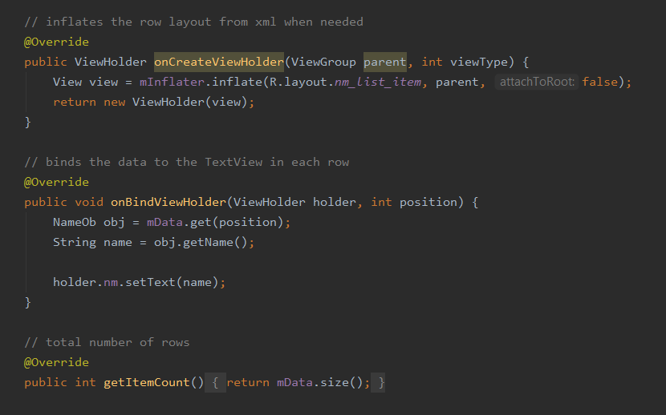
Adapter
Adapters provide a binding from an app-specific data set to views that are displayed within a RecyclerView.
When you define your adapter, you need to override three key methods:
onCreateViewHolder(): RecyclerView calls this method whenever it needs to create a new ViewHolder. The method creates and initializes the ViewHolder and its associated View, but does not fill in the view's contents
onBindViewHolder(): RecyclerView calls this method to associate a ViewHolder with data. The method fetches the appropriate data and uses the data to fill in the view holder's layout.
getItemCount(): RecyclerView calls this method to get the size of the data set.

Slide 23
Thank you

